Slide 1
FLIERS & BROCHURES

Slide 2
COMPARING FLIERS AND BROCHURES
 | FLIERS | BROCHURES
Size | Postcard size, one side of 8.5x11 inch sheet of paper | Usually six panels of text, the front and back of 8.5x11 inch sheet
Topics | Limited due to size, may focus on one aspect | More -5-10 aspects of the topic
Audience | On high tech or low tech audience | May gear towards any kind of audience, but most concentrate on potential clients, readers external to a company
Cost | Least expensive due to size | More expensive
Technology | Can be produced using standard word processing tools | Standard word processing tools
Longevity | Due to small size and limited coverage has less shelf life. Can be updated quickly | Long shelf life. Difficult to update
SIZE

Slide 3
Advantages of fliers
Cost effective
Time efficient
Responsive to immediate needs
Personalized- can be mailed, hand delivered.

Slide 4
Criteria for Writing Fliers
Keep the flier short(8.5X11 inch)
Focus on one idea, topic or theme per flier
Use a title to identify the theme- phrase, sentence, question-Software giving you a headache?
Limit your text-should be readable in a single sitting/a glance- 50 words per page
Increase the Font size- 16/20
Use Graphics- logo/address/contact details
Use Colour
Use Highlighting Techniques-
bullets, white space, tables, boldface, italics, headings, subheadings or columns
Find the Right Phrase-tag line
Recognize your Audience
Avoid grammatical Errors

Slide 5
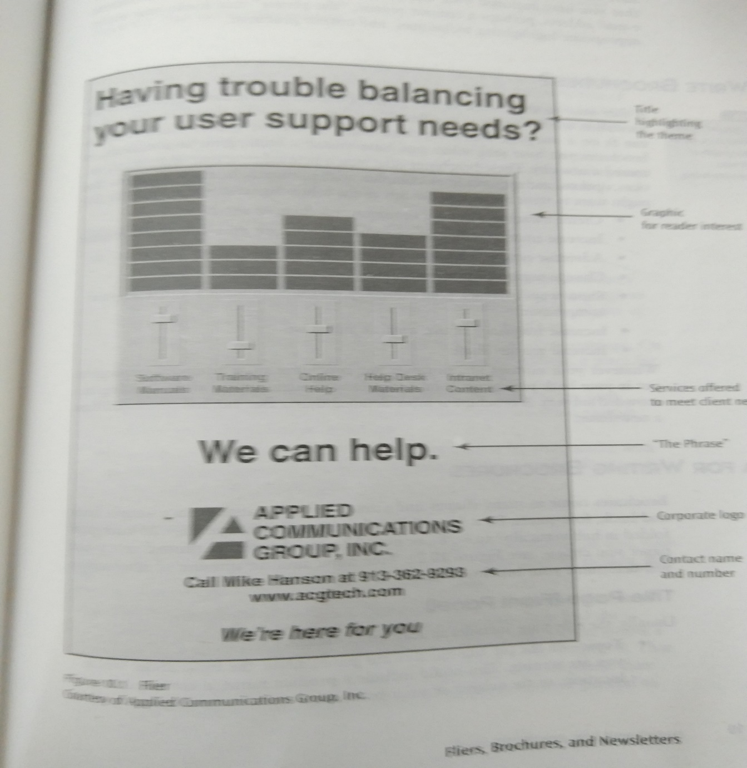

Slide 6
Pre writing
Who are you writing for( audience)
Why?
What idea you want to focus on?
How do you want to draw attention?

Slide 7
Brochure
Create awareness of your company, product, or service
Increase understanding of a product, service or your company’s mission
Advertise the new aspects of the company, product, service
Change negative attitudes
Show ways in which your company, product, or service surpasses your competition
Increase frequency of use, visit, or purchase
Increase market share

Slide 8
Writing of Brochures
Size
Different
Simple front & back/Four panel
Information on Brochure/s
Title page( Front panel): Includes three things- topic/graphic/contact information
Back page/panel
Conclusion/mailing address of senders/coupons/location

Slide 9
Body panels
Provide headings and subheadings –First level heading/second
All headings should be grammatically parallel(introduction,location,Payment options etc.) It’s where it began,here’s how to find us etc.
Use graphics
Develop your ideas (answer who, why, what, when, where and how)

Slide 10
Document Design
Limit sentence length-do not cramp
Use White space
Use colour,but donot over use
Bullet key points
Boldface or underline key ideas
Use graphics and their placement creatively

Slide 11
Audience Recognition and Involvement
Accuracy

Slide 12
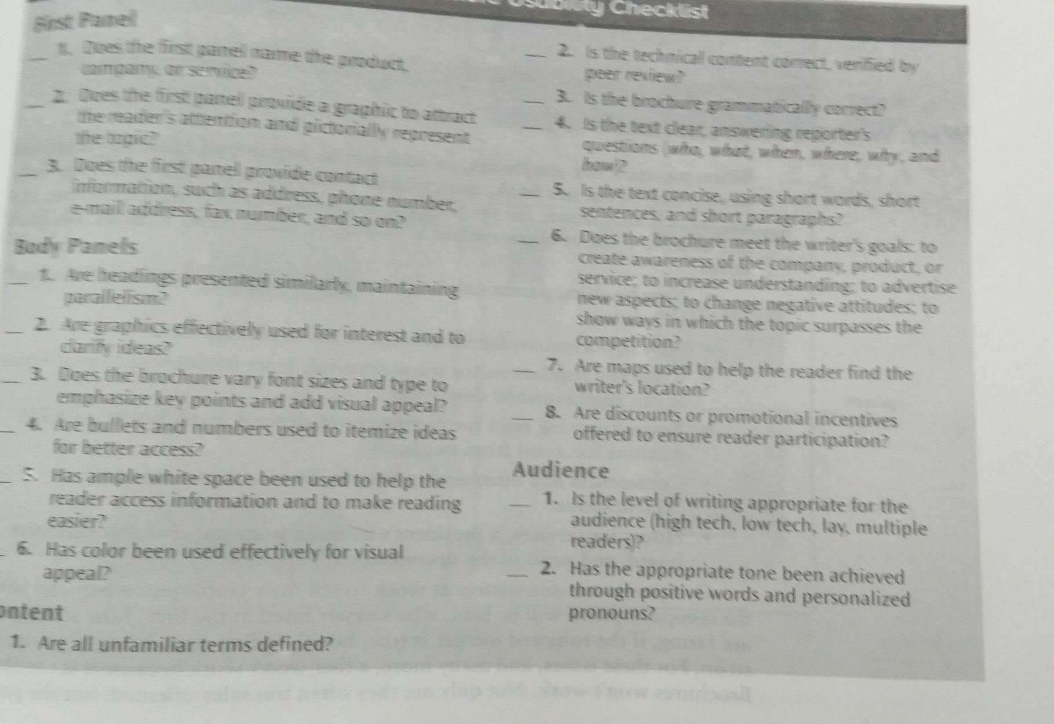

Slide 13
Samples
SampleCamp Brochure Sample 2010.pdf

